Slide 1
Function Problems

Slide 2
Write Functions
Asks users whether the user wants to continue of not, then returns the answer.
Takes two integers and returns 1 if 1st integer is divisible by 2nd integer, return 0 if not divisible.
Finds the factorial of a given number
Given two integers, finds the 1st integer to the power of the second integer

Slide 3
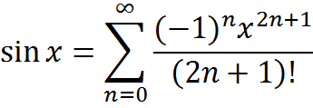
Write a program
Using the functions for factorial and power to calculate the equation below:

Slide 4
Write Functions
Given two numbers, returns 1 if 1st number is greater than 2nd number, 0 other wise
Given two numbers, returns the greater number
Given two numbers, prints the greater number
Given three numbers, returns the greatest number

Slide 5
Write Functions
Asks users to enter ten quiz grades, and returns the sum
Takes midterm (30%), lab (30%), and final (40%) grades and returns the semester end grade
Takes a numeric grade and returns the letter grade (A > 90, B > 80, C > 70, D > 60, and F)

Slide 6
Write Functions
Takes two points and returns the slope
Takes slope and a point and returns the y-intercept
Write a program that asks the user to enter two points (x1, y1) and (x2, y2) then prints the formula for the line passing through these two points
y = mx + a
where m is the slope and a is the y-intercept

