Slide 1
Arrays
Name, Index, Address

Slide 2
Arrays – Declaration and Initialization
. . .
70000
70004
70008
70012
70016
70020
70024
70028
. . .
. . .
5
11
22
. . .
. . .
5
11
. . .
. . .
5
. . .
. . .
. . .
. . .
5
11
22
11
. . .
. . .
5
11
22
11
44
. . .
int x;
int y[7];
x
x = 5;
y[0]
y[1]
y[2]
y[3]
y[4]
y[5]
y[6]
y[0] = 11;
y[1] = 2 * y[0];
y[2] = y[0];
y[3] = y[0] + y[1] + y[2];
addresses
&x is 70000
&y[0] is 70004
&y[1] is 70008
…
&y[6] is 70028
y means &y[0]

Slide 3
Arrays – Declaration and Initialization
. . .
70000
70004
70008
70012
70016
70020
70024
70028
. . .
. . .
5
. . .
. . .
. . .
. . .
5
11
22
11
44
33
55
105
. . .
. . .
10
11
22
11
44
33
55
105
. . .
. . .
10
11
22
11
44
33
20
105
. . .
int x = 5;
int y[7] = { 11, 22, 11, 44, 33, 55, 105};
x
y[0]
y[1]
y[2]
y[3]
y[4]
y[5]
y[6]
scanf(“%d”, &x);
10
scanf(“%d”, &y[5]);
20

Slide 4
Arrays – Declaration and Initialization
Declare, but not initialize
double xarr[5];
Declare and initialize
double xarr[5] = {1.1, 2.2, 3.3, 4.4, 5.5}
Declare, but initialize some
double xarr[5] = {1.1, 2.2}
3rd, 4th, 5th elements are initialized to 0.0
Declare and initialize without size
double xarr[] = {1.1, 2.2, 3.3, 4.4, 5.5}

Slide 5
Using Arrays
double x[8];
x[0] | x[1] | x[2] | x[3] | x[4] | x[5] | x[6] | x[7]
10.0 | 2.1 | 5.2 | 9.3 | 2.5 | 5.5 | 1.9 | -4.3
x[0] | x[1] | x[2] | x[3] | x[4] | x[5] | x[6] | x[7]
10.0 | 2.1 | 5.2 | 7.5 | 2.5 | 5.5 | 1.9 | -4.3
x[0] | x[1] | x[2] | x[3] | x[4] | x[5] | x[6] | x[7]
10.0 | 2.1 | 5.2 | 9.3 | 2.5 | 2.5 | 1.9 | -4.3
New x[3] = 7.5
New x[3] = 7.5
Prints 2.5
New x[3] = 7.5
Prints 2.5
Prints 10.0 + 1.9 = 11.9
New x[3] = 7.5
Prints 2.5
Prints 10.0 + 1.9 = 11.9
New x[5] = x[4] = 2.5
New x[3] = 7.5
Prints 2.5
Prints 10.0 + 1.9 = 11.9
New x[5] = x[4] = 2.5
Prints 2.1. New i is 1.
x[3] = x[5] + 2;
i = 4; printf(“%4.1f”, x[i]);
printf(“%.1f + %.1f = %.1f”, x[0], x[6], x[0]+x[6]);
i = 5; x[i] = x[i-1];
i = 2; printf(“%.1f”, x[--i]);
i = 2; printf(“%.1f”, x[i--]);
New x[3] = 7.5
Prints 2.5
Prints 10.0 + 1.9 = 11.9
New x[5] = x[4] = 2.5
Prints 2.1. New i is 1.
Prints 5.2. New i is 1.

Slide 6
Example 1
#include <stdio.h>
int main(void) {
int x[7];
x[0] = 5;
x[1] = 10;
x[2] = 15;
x[3] = 20;
x[4] = x[1] + x[2];
x[5] = x[0] + x[4];
x[6] = x[4] + x[5];
printf("The value of x[0] is: %3d\n", x[0]);
printf("x[0] + x[6] = %3d\n", x[0] + x[6]);
printf("x[1] * x[5] = %3d\n", x[1] * x[5]);
printf("x[6] - x[2] = %3d\n", x[6] - x[2]);
printf("\n");
printf("The address of array is: %d\n", x);
printf("The address of x[0] is: %d\n", &x[0]);
printf("The address of x[1] is: %d\n", &x[1]);
printf("The address of x[2] is: %d\n", &x[2]);
printf("The address of x[3] is: %d\n", &x[3]);
printf("The address of x[4] is: %d\n", &x[4]);
printf("The address of x[5] is: %d\n", &x[5]);
printf("The address of x[6] is: %d\n", &x[6]);
printf("The address of x[6] is: %d\n", &x[5] + 1);
return(0);
}

Slide 7
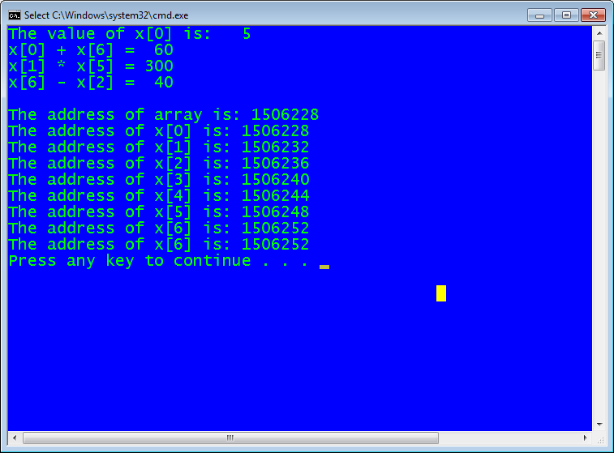

Slide 8
Arrays & Pointers
#include <stdio.h>
void PrntArry(double a[], int n);
int main(void) {
double x[4] = {10.23, 20.12, 44.44, 12.22};
double *ptr;
ptr = x;
PrntArry(x, 4);
ptr++;
printf("Array Element %8.2f\n", *ptr);
ptr++;
printf("Array Element %8.2f\n", *ptr);
printf("Array Element %8.2f\n", ++(*ptr));
printf("Array Element %8.2f\n", *(++ptr));
return(0);
}
void PrntArry(double a[], int n) {
int i;
for(i=0; i<n; i++)
printf("[%d]: %8.2f\n", i, a[i]);
}

Slide 9
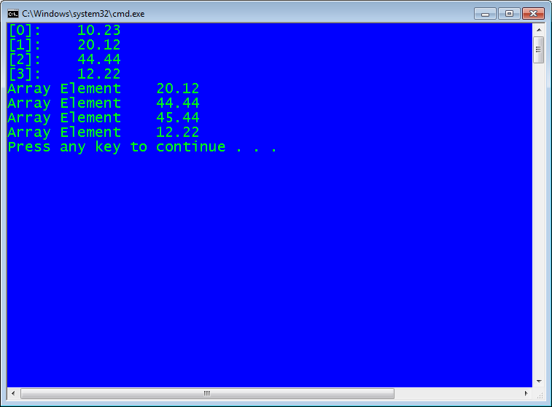
Arrays & Pointers

Slide 10
Arrays & Loops
int x[60]; /* 60 integers from x[0] to x[59] */
int i;
/* Fill array */
for(i=0; i<60; i++) {
printf("Enter array element %2d: ", i);
scanf("%d", &x[i]);
}
/* Print array */
for(i=0; i<60; i++) {
printf("Array Element %2d is %3d\n", i, x[i]);
}

Slide 11
Arrays & Functions
#include <stdio.h>
void FillArray(int arr[], int n);
void PrntArray(int arr[], int n);
int main(void) {
int x[60];
/* Fill array */
FillArray(x, 60);
/* Print array */
PrntArray(x, 60);
return(0);
}
void FillArray(int arr[], int n) {
int i;
for(i=0; i<n; i++) {
printf("Enter array element %2d: ", i);
scanf("%d", &arr[i]);
}
}
void PrntArray(int arr[], int n) {
int i;
for(i=0; i<n; i++) {
printf("Array Element %2d is %3d\n", i, arr[i]);
}
}

